Slide 1
DATA ANALYTICS

Slide 2
Brand sales-march 2019
Grand Total Sales of all the products in the year 2019 ie:the current year is 61.7% and the previous year is 38.3%.This infers the total sales made in the current year is larger than the sales made in the previous year.
March 2019
High demanded product -Multi Seg product-70.4%
Least demanded product-Hair Color-59.3%
Previous Year-
High demanded product-Hair color-40.7%
Least demanded product-Multi Seg product-29.6%

Slide 3
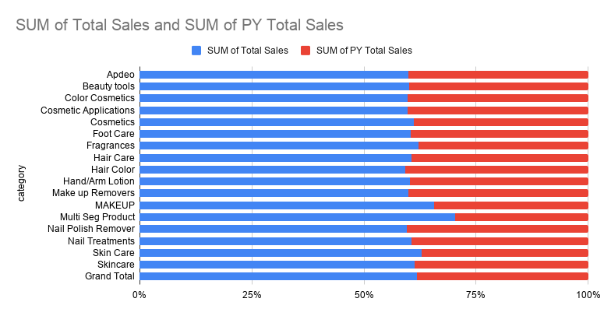
Brand sales-2019

Slide 4
Insights Monthly Data
The graph below infers that if a customer buys a brand in Fragrance,then the brand is definitely bleongs to revlon because among the total sales Revlon covers the 100% of fragrance.Hence Revlon is highly demanded on fragrance on both the years.
Customer has not bought any revlon brand on Foot care and this shows revlon brand is not recommended on Foot care.

Slide 5
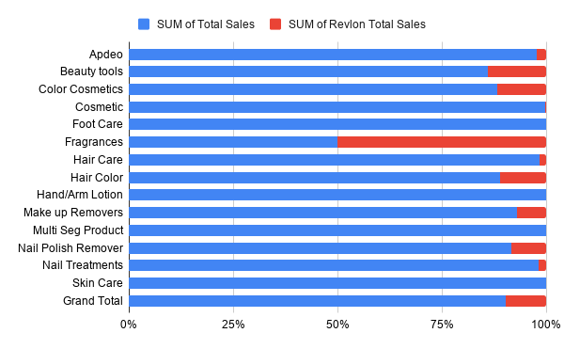
Present year

Slide 6
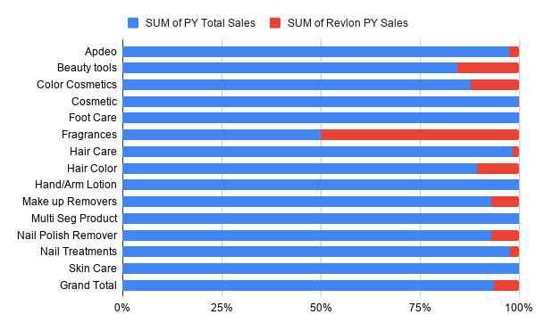
Previous Year

